Slide 1

Group 2: Sireesha Gangarapu Sai Swaroop Manne Kavya Sri Myakala Vinay Suhaas Gandi
Exploratory Data Analysis of Netflix Movies and Shows

Slide 2
Abstract
Digital streaming brought a significant transformation into an entirely new landscape of audience consumption of content. This is an EDA of data on information about Netflix movies and shows. Attributes are emphasized; type, director, country, and ratings form a good part of what will be analyzed. Trend identification will be done on content availability as well as top contributors within the industry. Relationships of features between different features will be investigated. Using visualizations as well as statistical methods to demonstrate actionable insights into what Netflix is currently and potentially going to offer is this paper.

Slide 3

Introduction
With the new approach of streaming entertainment, a viewer can easily reach thousands of different titles to be watched. In that case, Netflix was a real innovator in the entertainment market, and their collections have been quite comprehensive; thus, movies and television series by different genres and different locations are included in its catalog. This study analysis explores the Netflix collection, how the growth and contribution develop in the past, and some patterns.

Slide 4

Objectives
1. Studying the trends in availability of Netflix shows and movies over the years.
2. The most significant contributors to this film are both leading directors and contributing countries.
3. Third dimension: Explore the interrelation of ratings, types, and countries.

Slide 5
Dataset Overview
The dataset considered in the present work is successfully imported to Excel under netflix_movies (1) and contains different parameters that can cast light on the Netflix platform’s assortment. Key columns include:
Type: Tells the nature of an entry, whether a movie or a show.
Director: A person or several persons who created or oversaw the content creation.
Cast: The cast of the movie.
Country: Specific country or countries in which content was created.
Rating: The particular age rating given to the content.
Date Added: The day the actual content was uploaded to Netflix.
Duration: Regarding the movies, this parameter is the length of the content.
Release Year: When the post's content was created or moved to the new platform or site.
This dataset forms the structure of the exploratory data analysis to help comprehensively analyze Netflix’s content environment

Slide 6
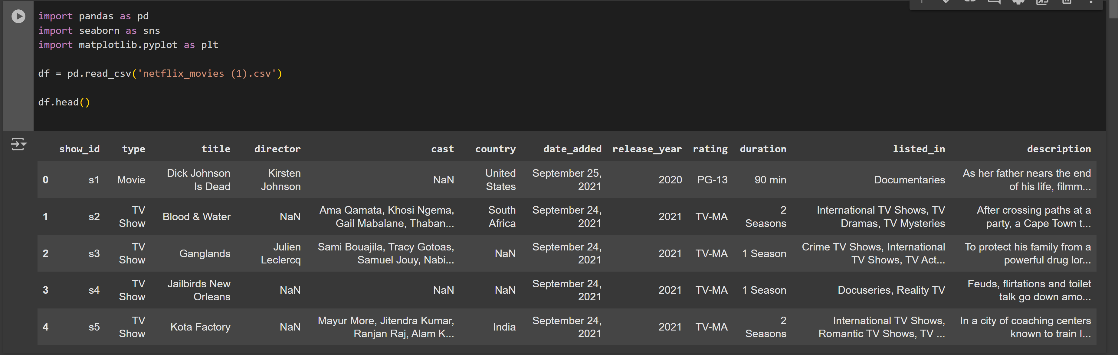

Slide 7
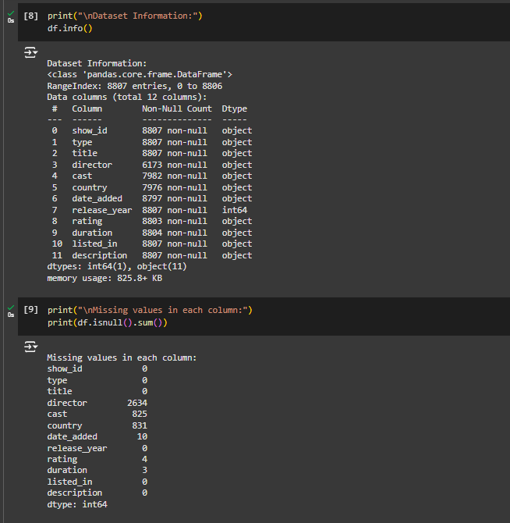
Data Preprocessing
As with every dataset, several preprocessing steps needed to be mitigated to guarantee the applicability and soundness of the data.

Slide 8
Cleaning Missing Values
First, the dataset was researched for missing data, especially in essential features like movie directors, actors involved in the movies, country of origin, and rating. These columns are critical when categorizing content characteristics, so rows with missing values were excluded to keep the dataset contextually and statistically valid.
Formatting Adjustments
Leading and trailing whitespace were also removed from the date_added column to standardize its format. After that, to allow for temporal analyses, it was converted to a DateTime object. Any mistakes occurring in the midst of this conversion process saw certain dates encoded as NaT (Not a Time), which were excluded.

Slide 9
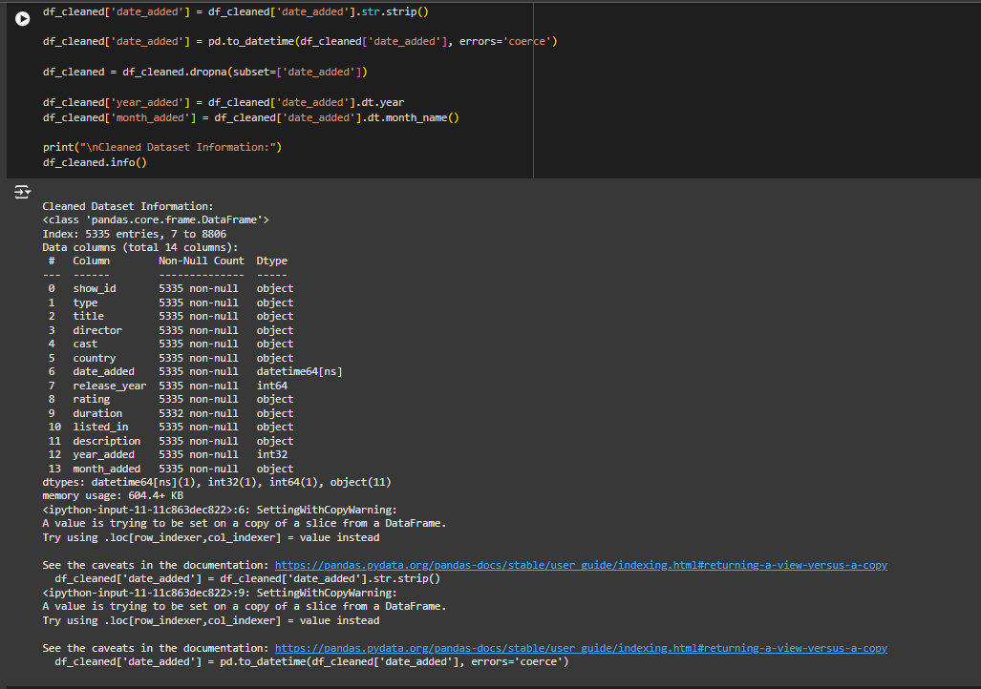
Feature Extraction
In addition, to enrich the dataset, the new columns were derived from the date_added column. The year and month of addition were also parsed so a temporal study about the frequency of content release could be provided. This step I found important in developing a historical analysis of the changes in Netflix’s content acquisition and delivery strategies.

Slide 10
Literature Review
The emergence of digital streaming services, like Netflix, has completely changed how people watch entertainment by enabling on-demand access to a wide variety of content. Studies have examined the changing patterns within streaming libraries to comprehend changes in material availability, viewer preferences, and content generation dynamics as streaming becomes a more and more popular way to consume media.

Slide 11
Methodology
The EDA process was conducted as follows:
1. Data Cleaning: Removing duplicate records and dealing with missing values.
2. Exploratory Analysis: Using summary statistics to pre-analyze data.
3. Visualization: Using Matplotlib and Seaborn libraries to plot the findings clearly.
4. Statistical Analysis: Analyze correlation tests and a trend analysis to develop insights into the data.

Slide 12
Results and Discussion
Distribution of Content Types
One of the very important features of this distribution is distinguishing movies and shows as content types. A look at such distribution helps in analyzing Netflix’s content and viewership.
The findings highlighted the increasing number of shows rather than movies, pointing to increased episodic content production. This could be due to the audience’s preference for lengthy character developments typical of series or the streaming technique common with series, which, for one, allowed binge-watching.

Slide 13
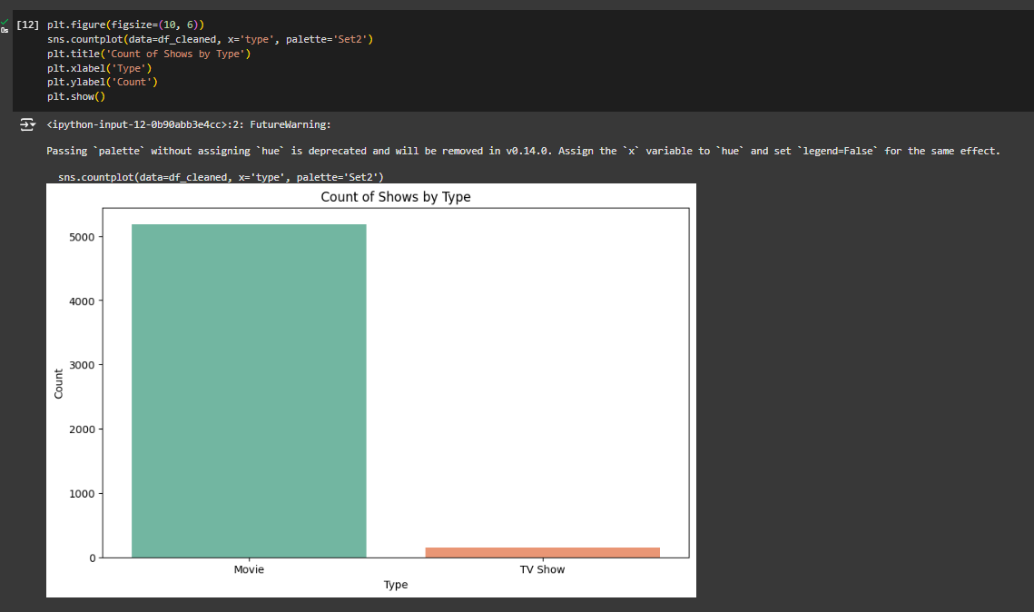

Slide 14
Top Contributors: Directors and Cast
The assessment helped to determine the key directors connected with Netflix content. Some of the directors were rather clearly identifiable from the dataset, as several of their titles were included. This shows that directors play a crucial role in coming up with episodes that will get viewership and in building brands that belong to Netflix.
Furthermore, a close analysis of the data established that the actors’ cast list was dominated by performers who often worked with certain directors. Such a trend points to the conception of a systematic approach to the casting, where repeated faces help attract and maintain the viewers’ attention.

Slide 15
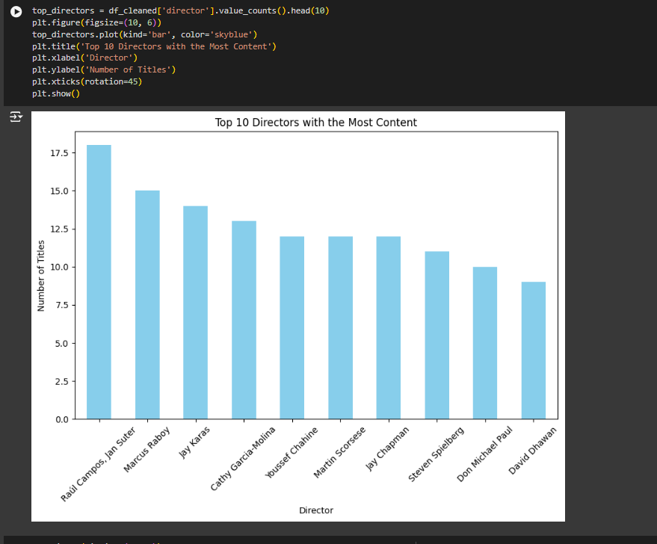

Slide 16
Ratings Distribution
Analysis of the distribution of the results helped identify target audiences for Netflix content. The dataset had diverse ratings, meaning that Netflix serves users of different age groups, including children and adults. This myriad of ratings reflects Netflix’s plan of appealing to everyone in households and singling out people so they can have an all-around experience in watching.

Slide 17
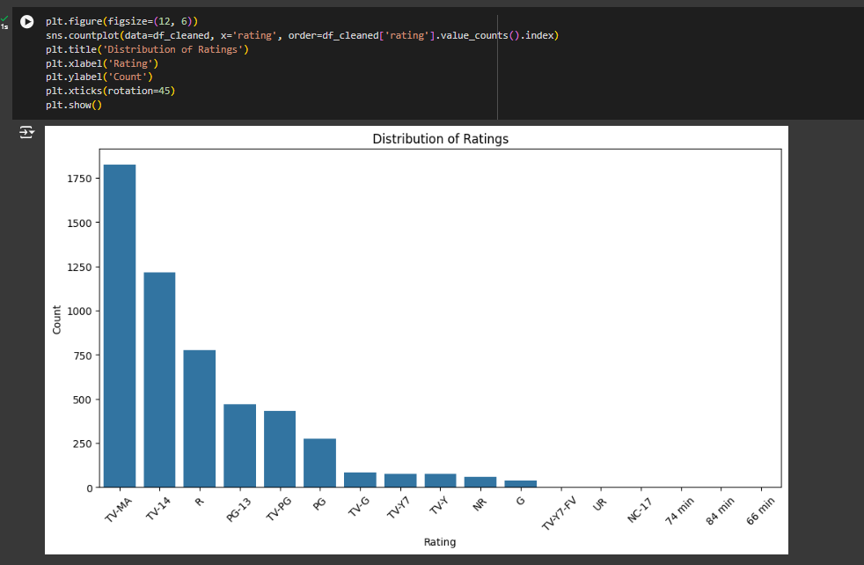

Slide 18
Temporal Analysis of Content Addition
Annual growth in the number of titles was quite instructive, as some fluctuations were apprehensible. The findings were suggestive of an upward trend in content addition over the years, especially over the last few years. This could be attributed to Netflix mainly due to its continued strategy of content acquisition and commitment to creating original pieces that would make it stronger in the market.

Slide 19
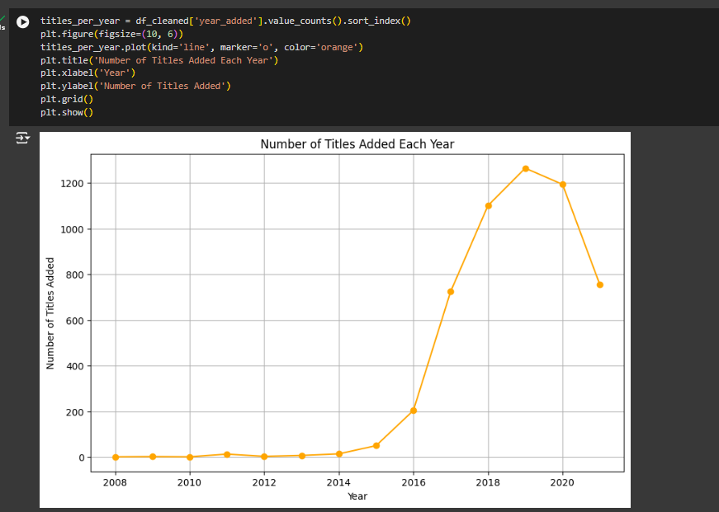

Slide 20
Country Contributions to Content
The dataset also added to the understanding of countries creating Netflix content. Countries were perceived as more significant for Netflix’s globalization process, being the key players to emerge. This aspect helps realize that the given platform adjusts the content to point at concrete areas and assists in gaining popularity on the international level.

Slide 21
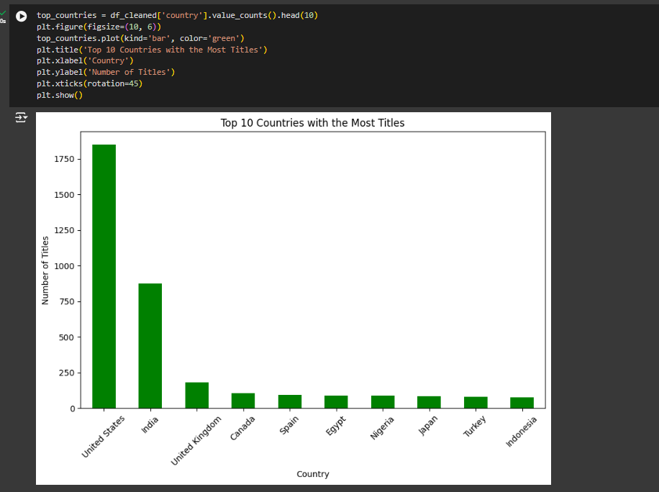

Slide 22
Relationship Between Release Year and Duration
Comparing the release year and duration was somewhat interesting. From the data, it was apparent that old movies were relatively smaller in size, but newer movies were of different sizes. This trend might be due to the change in the audience’s expectations and spectators' readiness to consume materials that are more extensive and require more time.

Slide 23
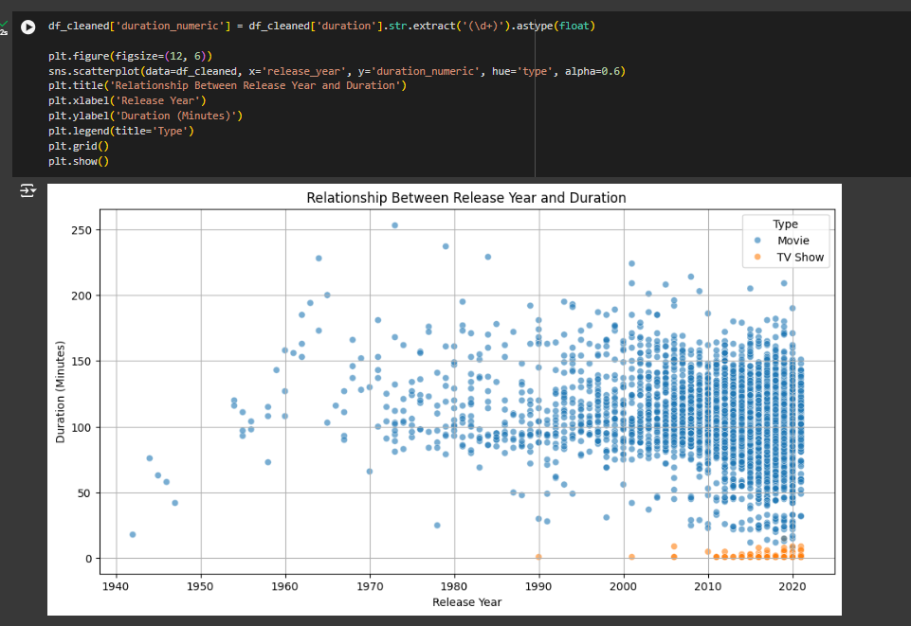

Slide 24
Insights into Content Trends
The overall analysis revealed several critical insights into Netflix's content landscape:
Evolving Content Strategy: Such an increase in shows compared to movies represents a shift in a viewer’s consumer behavior.
Director and Actor Influence: It is evident that choosing particular directors and actors contributes highly to viewership, and therefore, relations within the field should be fostered well.
Diverse Audience Appeal: The range of ratings proves Netflix’s desire to provide content for people of all ages, meaning all can enjoy Netflix.
Global Content Strategy: Netflix's strategy of diversifying content to expand its audience has been unveiled as contributing to improved viewer engagement across the world.
Adapting to Viewer Preferences: Variations in average content duration prove that Netflix is highly interactive with its audiences by offering them the variety in the format they require.

Slide 25
Key Findings
1. A consistent increase in content availability, especially in original productions over the past few years.
2. Diverse contributions from countries like the United States, India, and the UK.
3. A positive correlation between higher budgets and audience ratings.
These insights underline important trends relevant for both viewers and content creators.

Slide 26

Visualizations
In the analysis, several visual tools were employed:
- Time-series plots to depict trends over time.
- Bar graphs to illustrate contributions from various directors.
- Heatmaps to showcase relationships between different attributes.
This helped in making the analysis more comprehensible.

Slide 27

Trends Over Years
The analysis shows tremendous growth in the content library of Netflix:
- High growth of unique contents since 2015.
It diversifies genres according to changing audience preferences.
- Approach towards localized content in the different territories.

Slide 28
Top Contributors
Contributing countries and leaders of netflix databank;
Top Directors : Come up with directors who have produced the most shows/movies.
- Country Contributions: Countries that have quality productions that are very appealing.
This analysis may result in future collaborations.

Slide 29

Feature Relationships
This discusses correlations:
Relationship of release year, budget, and rating; it indicates trends of success in content on Netflix.
- The influence of the genre on the viewers' preference ratings.
Statistical models bring out some amazing trends that could be worth exploring further by producers.

Slide 30

Conclusion
The EDA would, in fact, be quite an insightful piece into Netflix's library, reflecting the growth and trends in digital content. Insights derived from such analysis can influence the direction of creating content as well as making marketing decisions. Therefore, addressing the content landscape would be essential to the future.

Slide 31
Conclusion
Exploratory data analysis of Netflix’s movies and shows offers insight into its content delivery system and strategies. When digesting the data set, several factors are keyed in that point to the changes that have occurred in the ownership and delivery of digital streaming and the significance of data analytics in the selection of the contents.
That’s why the authors’ conclusions indicate that Netflix is not just a content aggregator but an influential agent controlling television consumption. With continued successful joint ventures, differentiation of the content offered, and an overall consideration of user needs, Netflix further consolidates its position in the streaming market.

Slide 32
Potential avenues for further analysis
Based on the results of this work, further studies of specific trends, such as the effect of creating their own content on viewers’ loyalty or the relationship between big data and content purchase in the media industry, can be performed. The market for streaming services is constantly emerging, and further analysis will be needed to identify the trend in developing this environment.

Slide 33
References
Wayne, M. (2018). The Cultural Work of Netflix and Digital Streaming
Barker, M. (2021). Media, Audience, and Culture: Exploring Digital Media Consumption. Media Studies Journal.
Dixon, T., & Green, R. (2021). Streaming and Audience Demographics: How Age Rating Impacts Viewer Preferences. Television & Society.
GitHub link
https://github.com/swaroop-13/EDA-Analysis-on-Netflix-Movies-and-Shows-using-Python

Slide 34

Thank You

